Slide 1
2022 DWC Friends of Scouting Presentation

Slide 2
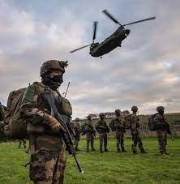
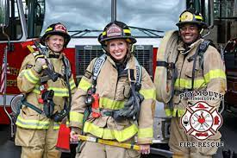
Heroes
Who do you picture when you think of a hero?

Slide 3
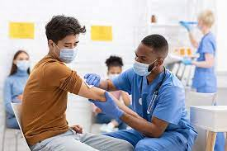
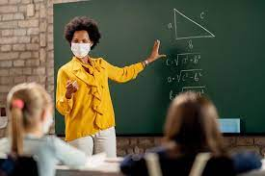
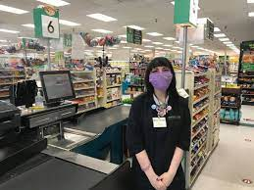
Heroes in 2022
During COVID, we have been surrounded by heroes!

Slide 4
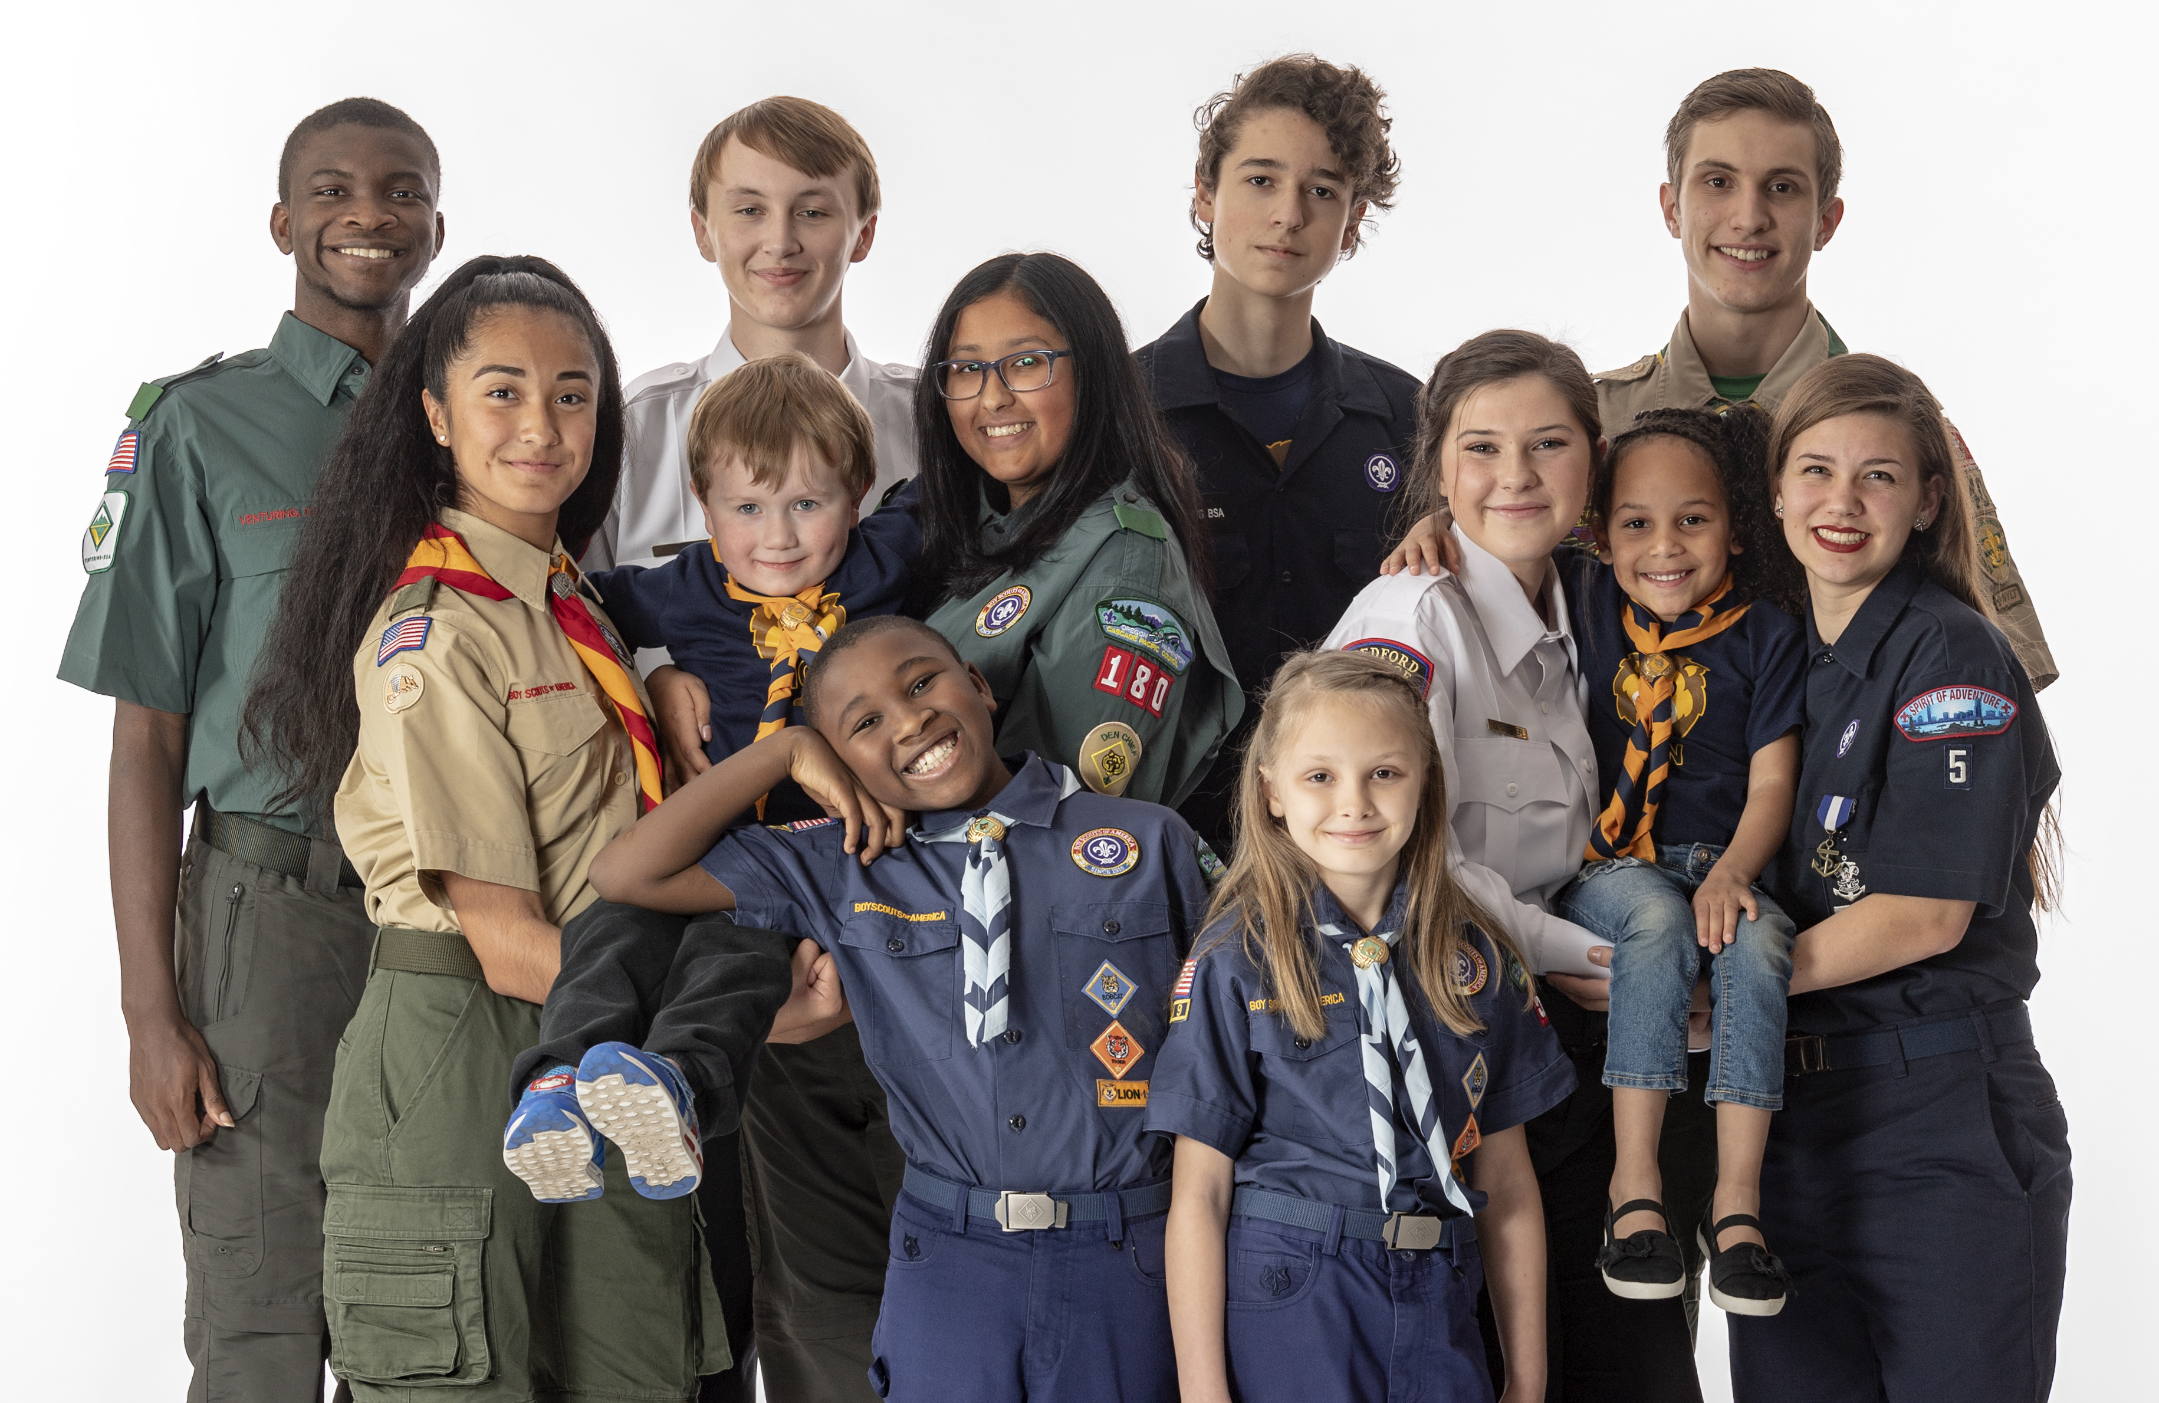
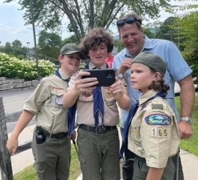
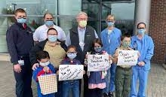
Heroes of the Future

Slide 5
We Need Your Help
Help us develop your children into the heroes of the future
Daniel Webster Council spends almost $500 on each youth every year
That money comes from grants, fees, fundraisers, product sales and donations from families just like yours!
Your gift today will help Keep Scouting Granite Strong, and will help us develop the Heroes of the Future

Slide 6
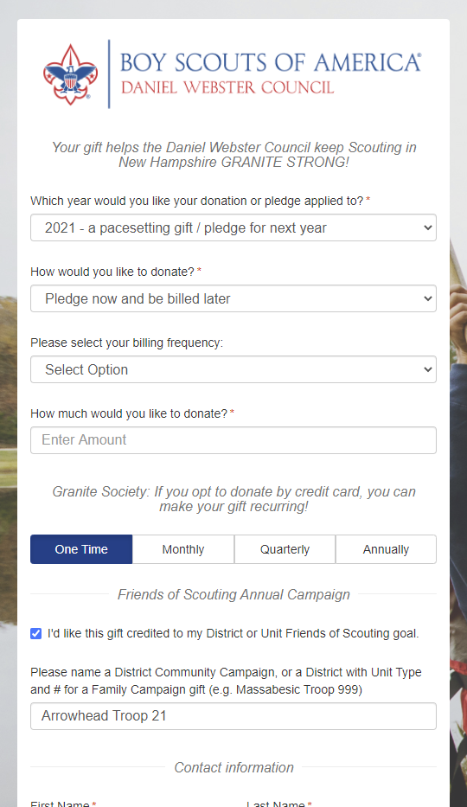
How to Help
Pledge or donate today
Pledge online at:
https://nhscouting.org/donate/
Look for employer matching

Slide 7
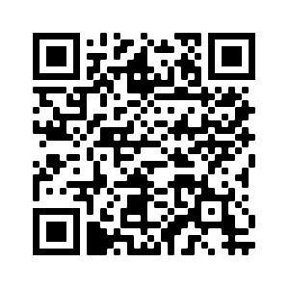
2022 Unit Incentive
Every Unit that 100% participation will receive a $50.00 in the Unit Account.
100% will need to be verified by the Daniel Webster Council Office & FOS Chair.
Units to submit Incentive Confirmation Form by 12/31/22 - https://www.cognitoforms.com/BSA4/_2022FriendsOfScoutingUnitIncentive

Slide 8
Video

Slide 9
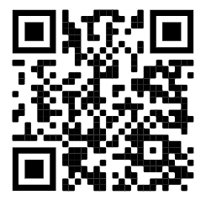
Video
https://www.youtube.com/watch?v=gJVAimk9cyw

